Slide 1

EAGLE 3x3 CHALLENGE SYSTEM
The Next Step in Fair & Transparent 3x3 Basketball
First dedicated video-challenge system built exclusively for 3x3 competitions.

Slide 2
CHALLENGES OF 3x3
3x3 Basketball: High Speed. High Pressure. High Risk.
Decisions made in a second
Frequent unclear situations (lines, clearance, contact, timing)
High number of protests and team complaints
Accusations of poor or biased officiating
No standardized video-review system
Negative impact on credibility and reputation of organizers
The sport is fast — but fairness must be faster

Slide 3
WHAT VOLLEYBALL TEACHES US
Volleyball Had the Same Problem — Until Challenge System Arrived
Constant disputes over block-touch, line and ball-touch decisions
Heavy pressure on referees and organizers
Credibility and trust issues
After introduction of the challenge system:
Controversial situations almost eliminated
Trust from teams and spectators increased
Line judges fully removed
Technology became the standard
The same transformation is now needed in 3x3.

Slide 4
REAL 3x3 OFFICIATING ISSUES
Controversial Calls in Real 3x3 Games
Was the foot on the line?
Was clearance completed correctly?
1 or 2 points?
Shooting before/after shot clock?
Airborne contact and foul classification
End-of-game timing decisions
One unclear call can decide a game — and a tournament.

Slide 5
WHAT A WRONG CALL COSTS
The Risk for Organizers
Protests and match delays
Negative reactions from teams and fans
Reputation damage
Potential loss of sponsors and TV partners
Unprofessional image in front of FIBA officials
Long-term trust issues
Fairness is not optional — it’s an investment in credibility.

Slide 6
EAGLE 3x3 OVERVIEW
Eagle 3x3 — The First System Built Exclusively for 3x3
Full transparency and equal conditions
Significant reduction of disputes
Clear and fast decisions
Real-time big screen output
Independent from TV crews
Professional standard for any competition
Reliable. Transparent. Designed for 3x3.

Slide 7
WHY EAGLE 3X3 IS DIFFERENT
Purpose-built system for 3x3 (not adapted TV tech)
Works without TV production
Fast installation and compact setup
Multi-angle slow motion review
Professional tools for referees
Proven experience from volleyball challenge systems
Modular hardware — scalable to all venue types
Only system optimized for the rhythm and speed of 3x3.

Slide 8
WHAT ORGANIZERS GET
Benefits for Organizers
professional tournament image
eliminated disputes and reduced pressure
faster games without interruptions
audience engagement with big screen output
Benefits For Referees
multi-angle slow motion
accurate decision-making
less pressure and fewer arguments
Benefits For Teams
full transparency
equal conditions
trust in decisions

Slide 9
REFERENCES
Already Tested in Real Competition Conditions
Events:
BG 3x3 League 2025
Bulut Hoops 2025 (Dušan Domović Bulut)
TV Arena Sport support
Feedback from referees:
92% accuracy improvement
0 appeals after challenge
higher trust from players
Proven technology, verified in real 3x3 environments.

Slide 10
HARDWARE OVERVIEW
Eagle 3x3 Hardware — Key Points
12 high-framerate cameras
Global shutter sensors for perfect freeze frames
Optimized for fast-moving 3x3 action
Stable and consistent output
Fully compatible with big-screen and broadcast systems
Engineered for precision under pressure.

Slide 11
CAMERA PLACEMENT
Optimal Court Coverage
Ground-level cameras for lines and arc
Mid-level and jump-level cameras for contact and fouls
Basket-level camera for goaltending and interference
Timing cameras for shot-clock and game-clock verification
Complete visibility of every critical angle.

Slide 12
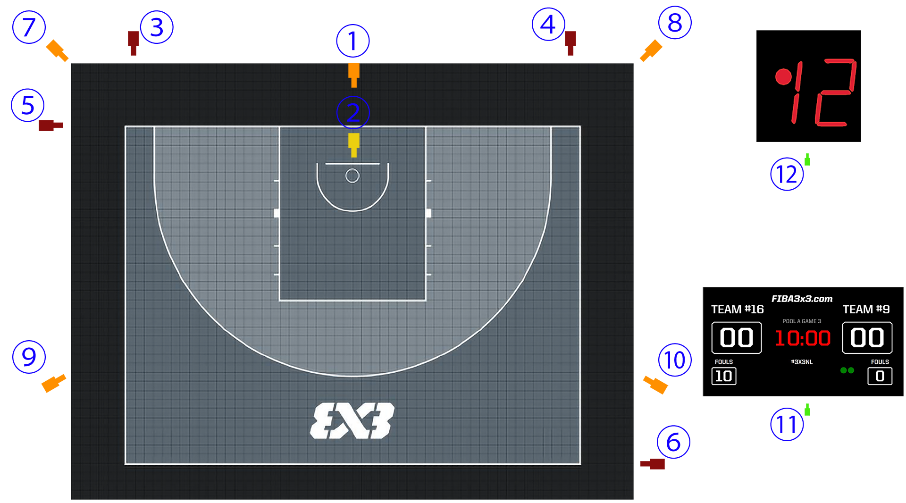
Camera placement – full installation

Slide 13
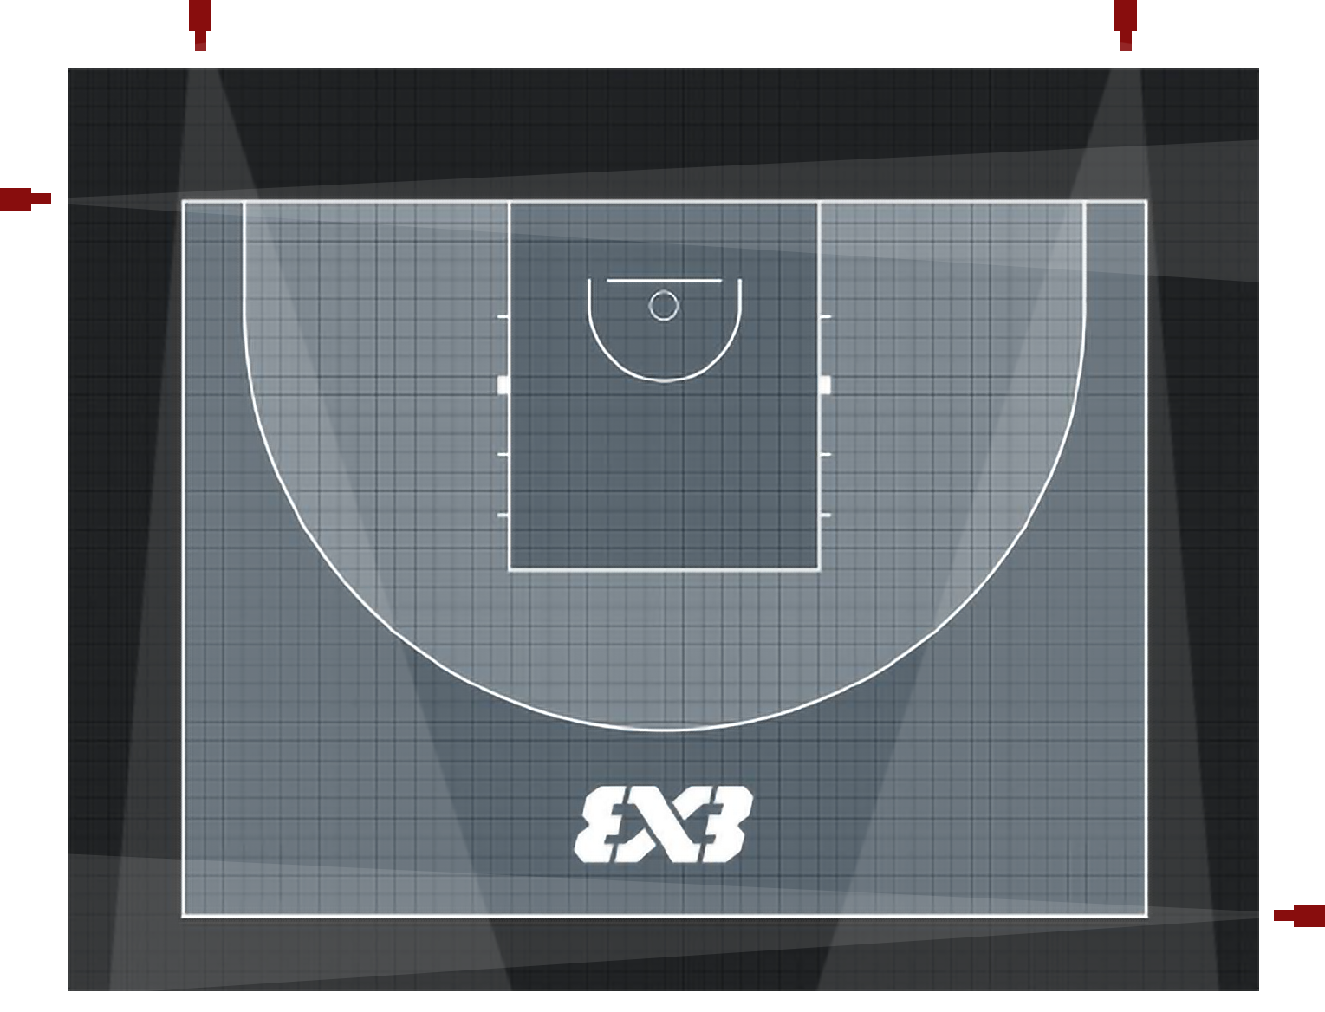
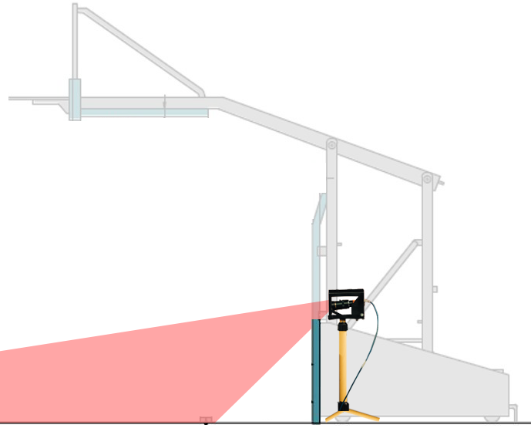
Camera placement – ground level cameras
3
4
5
6

Slide 14
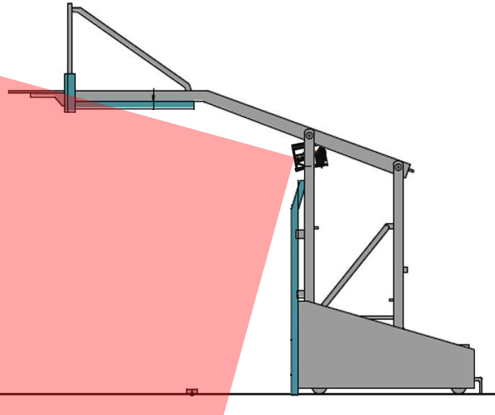
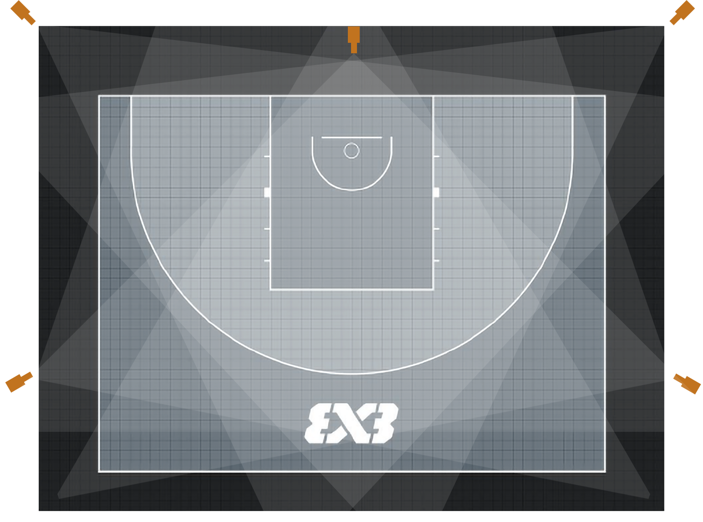
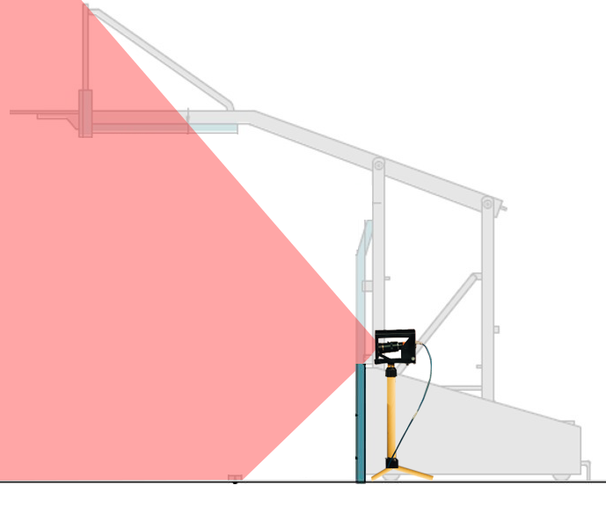
Camera placement – jump height cameras
7
1
8
9
10

Slide 15
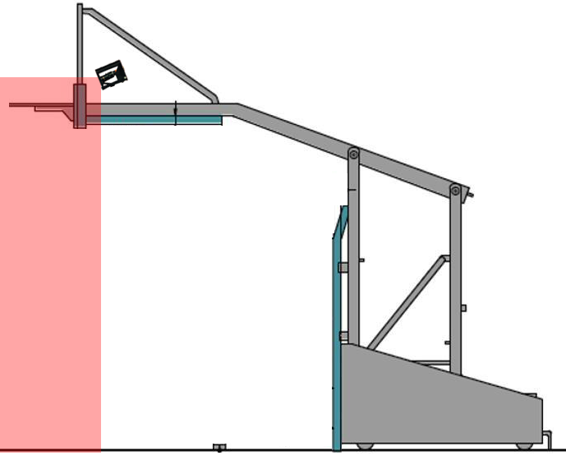
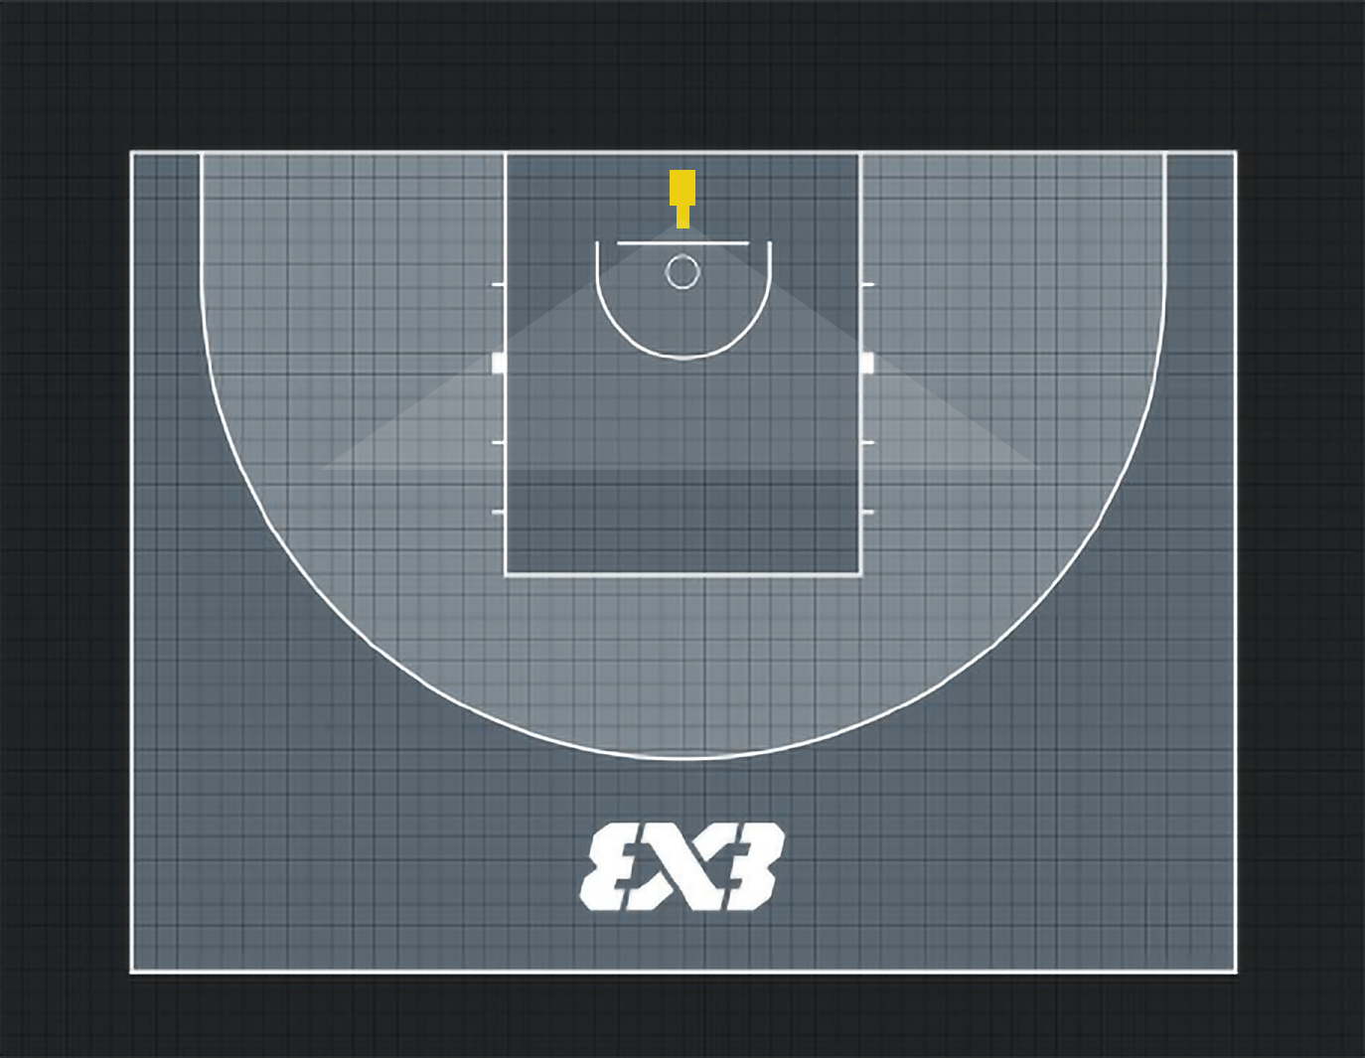
Camera placement – basket level camera
2

Slide 16
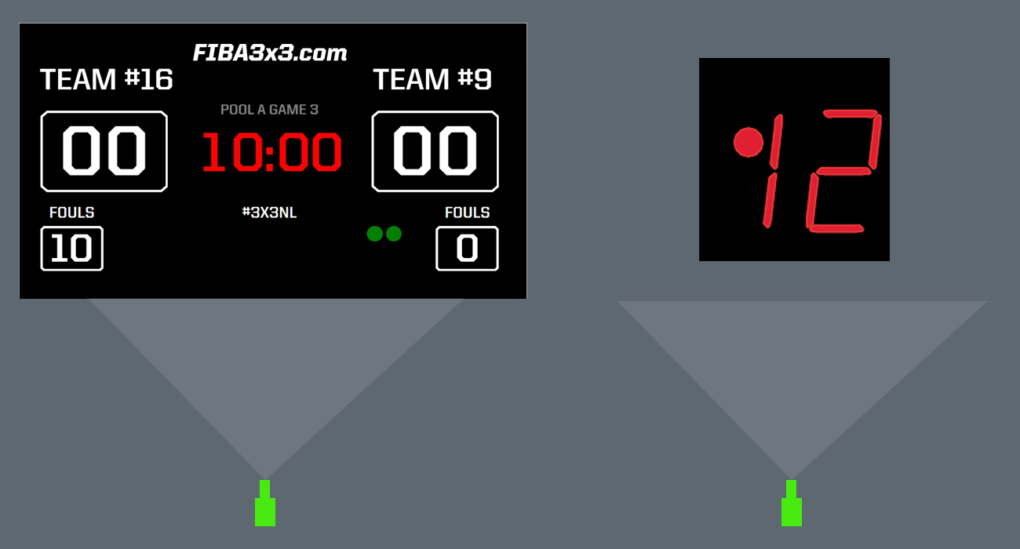
Camera placement – timing cameras
11
12

Slide 17
SOFTWARE INTERFACE
Eagle 3x3 Software — Built for Referee Needs
Instant multi-angle playback
Synchronized camera switching
Precise timeline controls
Visual tools for easier decision-making
Video export with full graphics
Referees make the final decision — technology makes it clear.

Slide 18
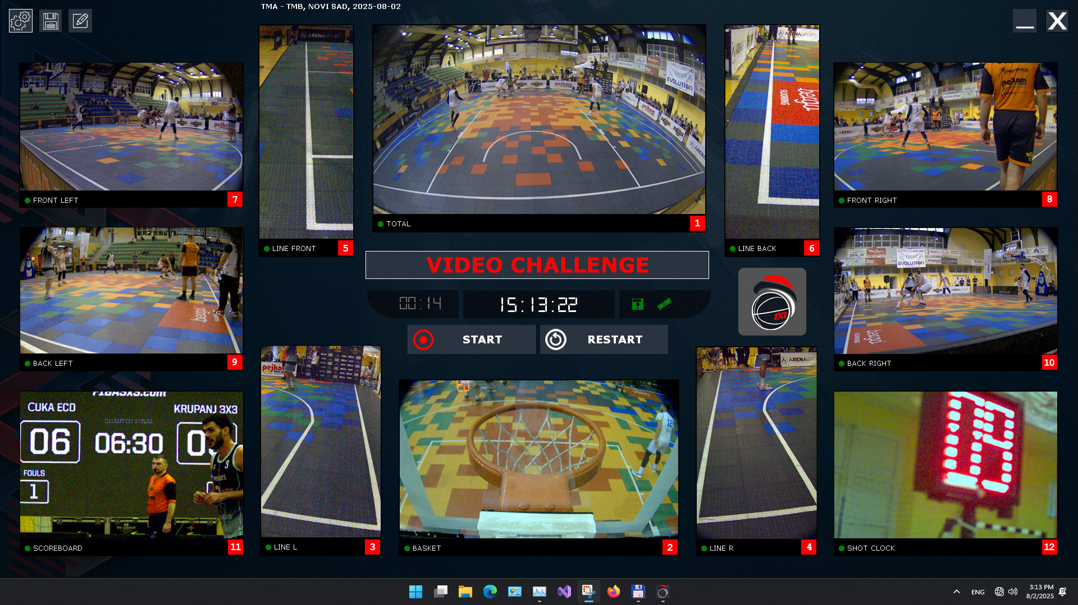
Eagle 3x3 – main software window

Slide 19
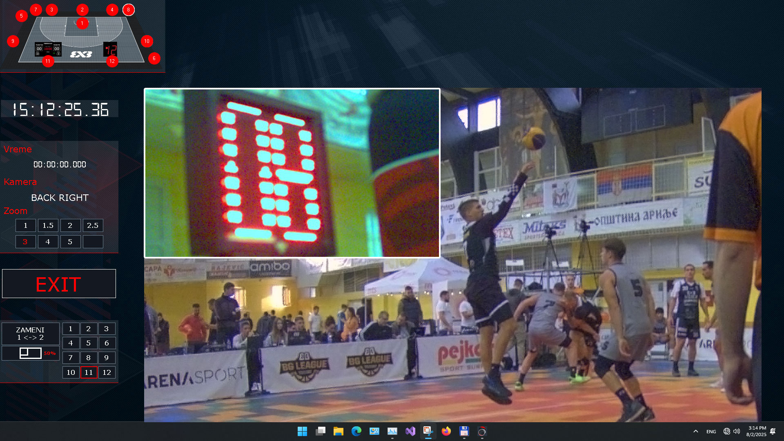
Eagle 3x3 – software challenge window

Slide 20
WHAT CAN BE CHECKED
Situations Covered by Eagle 3x3
Out of bounds
Clearance review
1 or 2 points
Shot-clock review
End-of-game timing
Goaltending / Interference
Foul classification
Shooting foul
Offensive / Defensive foul
Full compliance with FIBA & national federation protocols.

Slide 21
EAGLE vs. TV PRODUCTION — KEY DIFFERENCES
TV Technology
Depends on TV crew
Limited angles
Not optimized for referee review
No instant multi-angle synchronization
Eagle 3x3
Fully independent system
Uniform playback
Exact action-point alignment
Up to 6× zoom
Designed specifically for officiating
Better than TV for refereeing — lighter, faster, clearer.

Slide 22
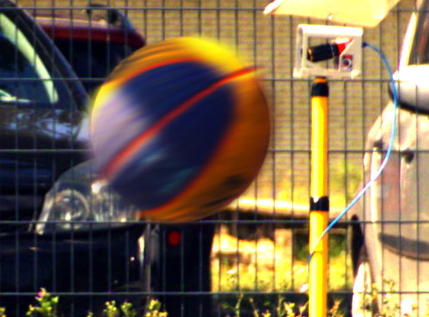
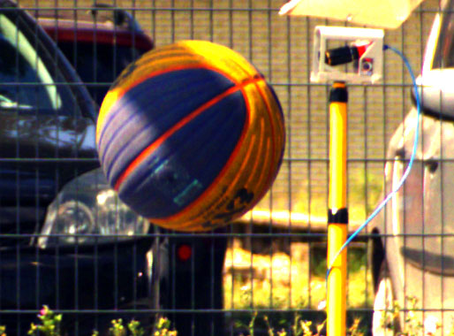
Sharp details on image
TV CAMERA TECHNOLOGY IMAGE
EAGLE TECHNOLOGY IMAGE

Slide 23
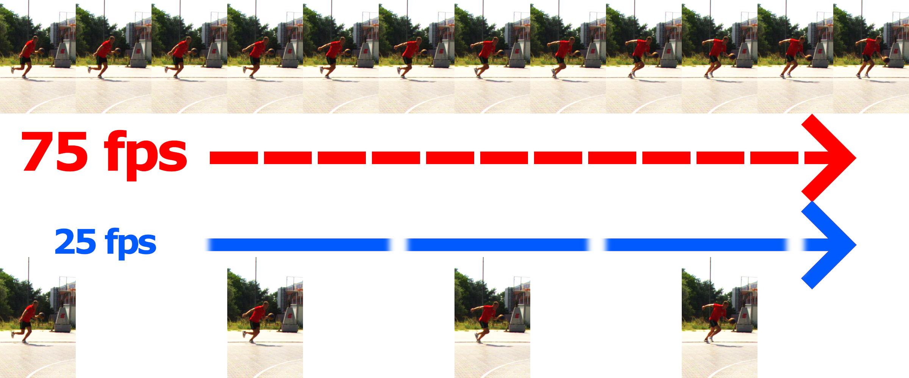
75 vs 25 fps

Slide 24
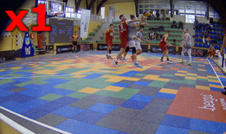
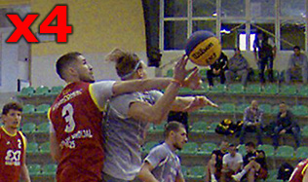
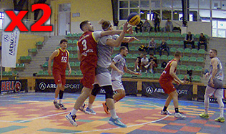
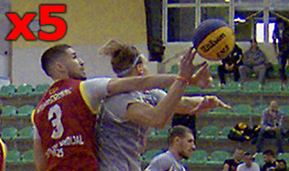
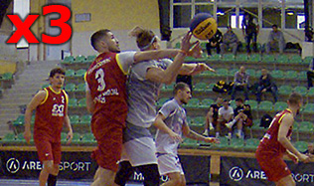
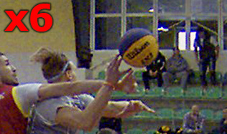
Up to 6x zoom on image in steps

Slide 25
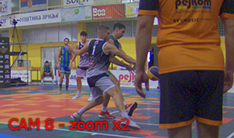
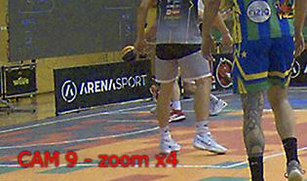
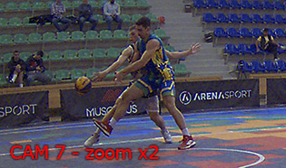
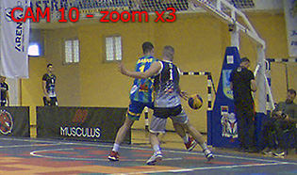
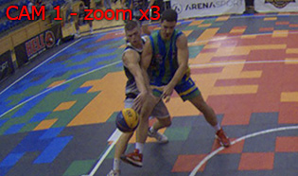
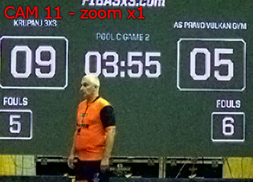
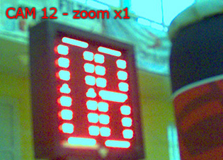
Multiangle review
SAME ACTION
SAME POINT IN TIME
&

Slide 26
CHALLENGE WORKFLOW
Operator rewinds action as referee approaches
Multi-angle slow-motion review
Referee evaluates and confirms final decision
Result immediately shown on big screen / TV
System saves the challenge for post-game evaluation
Fast, clear, and interruption-free.

Slide 27
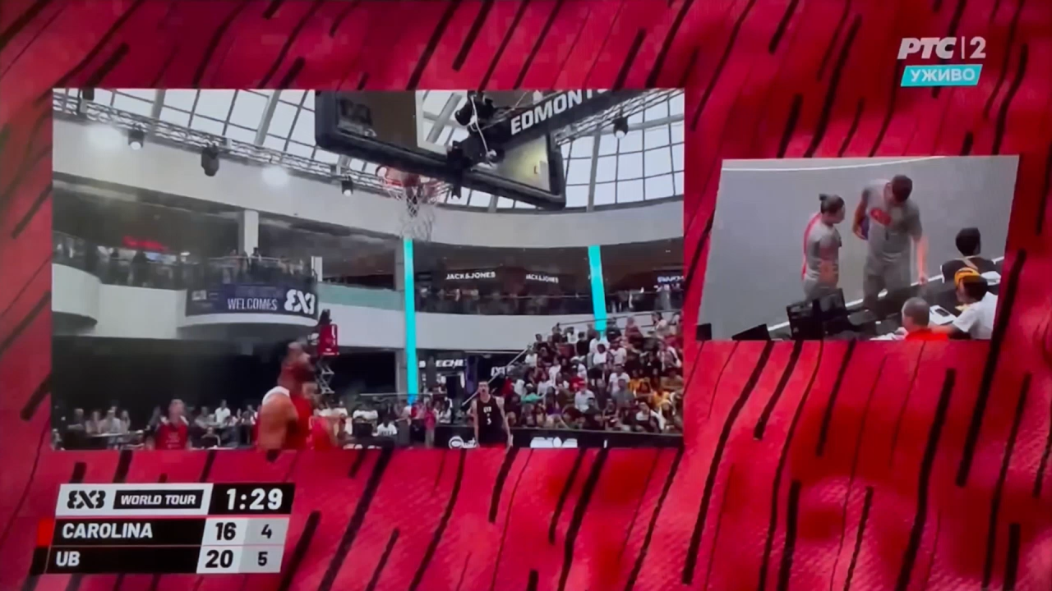
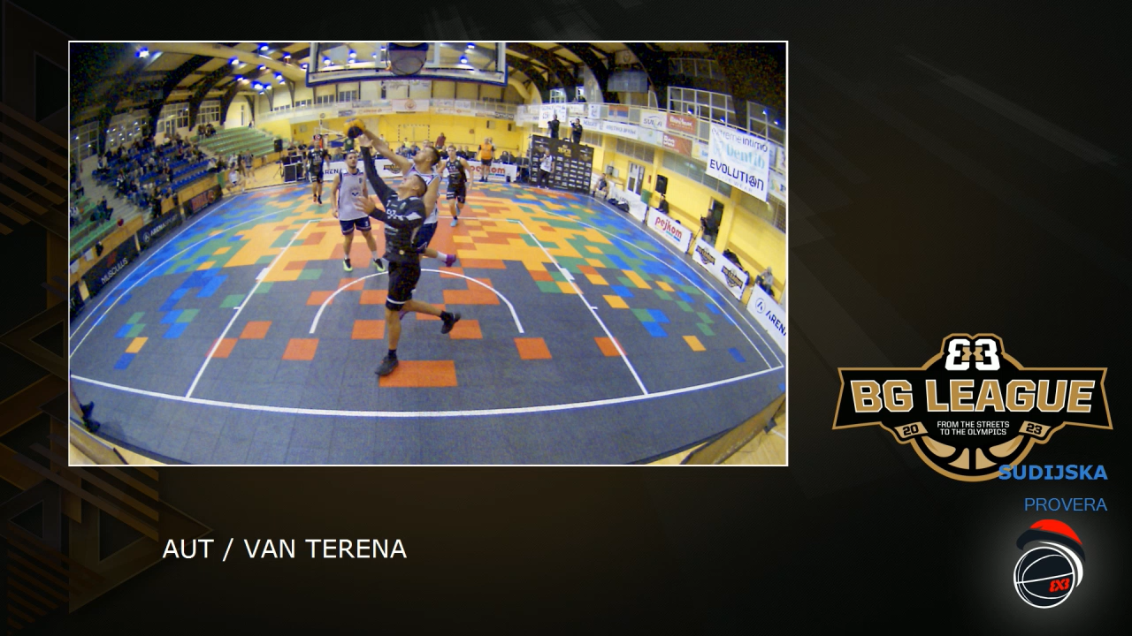
RESULT PRESENTATION
Uneven play over the course of the action
Controlled by operator
Variable duration and no precise action point
Uniform play every time
Automatic generation of video by the computer
Always same duration and showing exact action point

Slide 28
RESULT PRESENTATION
Result Presentation & Broadcasting
Big screen output with graphics
Clean feed for TV OB Van
Saved video files for archives and evaluation
Professional presentation for audience, teams,
and media.

Slide 29
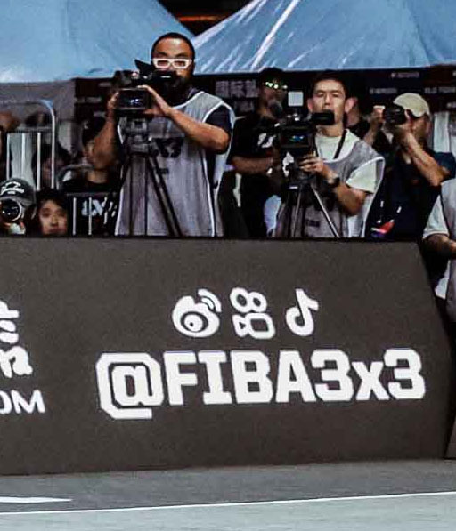
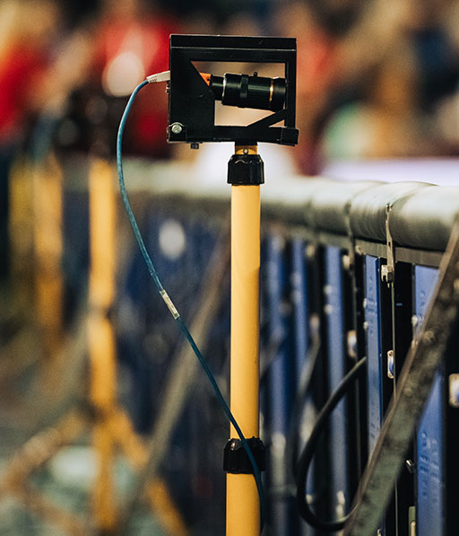
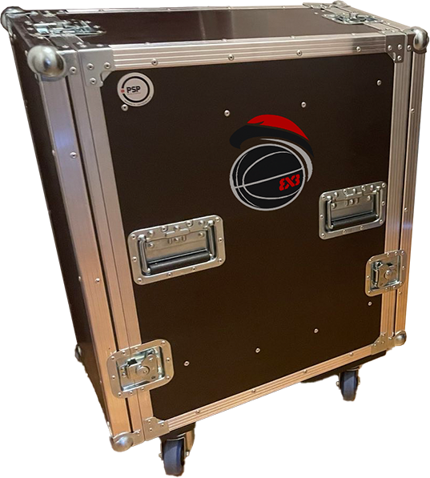
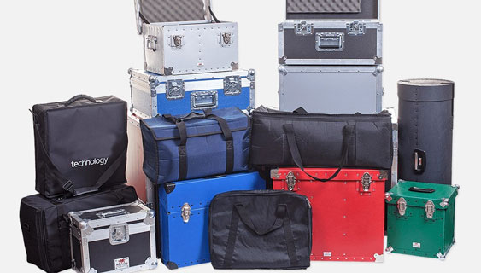
INSTALLATION & LOGISTICS
Fast Installation — Minimal Requirements
Compact setup
Operator positioned beside the court (1 m² space)
Quick pre-game calibration (less than 1h)
Full readiness within minutes
TV
EAGLE
Designed for tournaments with tight schedules.

Slide 30
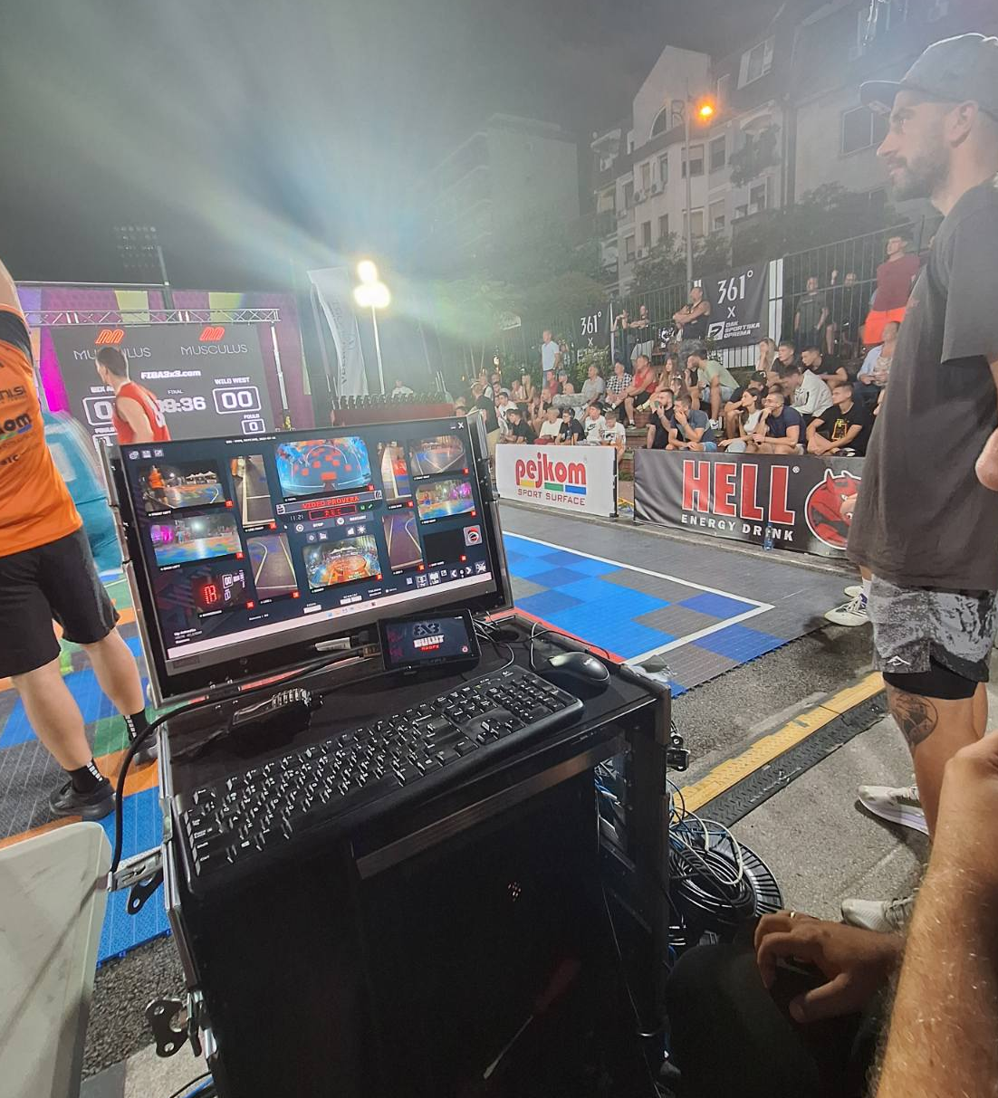
TIMELINE
Development Timeline
Q2 2025: System finalized
Q3 2025: Real-game implementation
Q4 2025: Full commercial readiness
2026: Deployment for international tournaments
Proven, tested and ready for 2026 season.

Slide 31
DAILY RENTAL PACKAGE INCLUDES:
12 cameras
operator
full installation
big screen output
instant video exports
FIBA 3x3 compliant challenge structure
Multi-day discounts available.

Slide 32


We are available for all your questions
Make the game even more fair
Book your 2026 competition
office@newevent.rs
+381 65 81 84 000 Darko Savić

